Slide 1
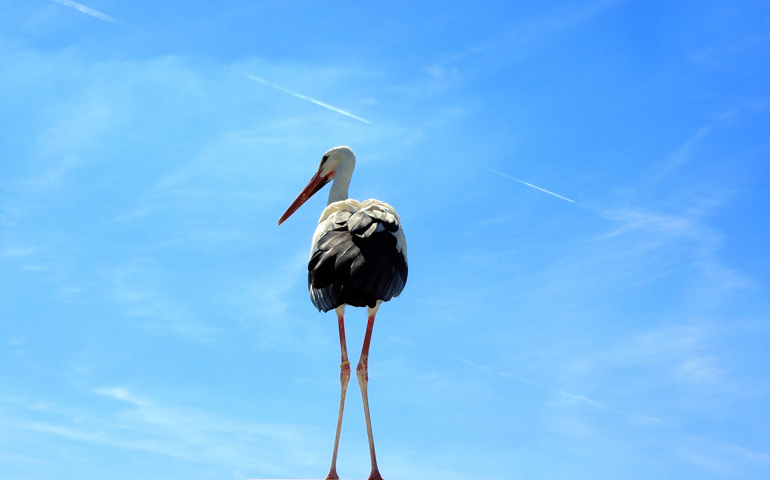
BENDING, BREAKING, BLENDING
BQ5 Creativity Lesson 2
I can explain how new ideas are created, and support my discussion with examples from different AOKs
Notes:
See how this lesson links to the course by viewing the final slide
Key TOK terms appear in a red font

Slide 2
Starter
How are new ideas created?
Try to draw on examples from your own life.

Slide 3
Adding to your ideas - ‘connections’
“Creativity is just connecting things. When you ask creative people how they did something, they feel a little guilty because they didn't really do it, they just saw something. It seemed obvious to them after a while.” (Steve Jobs)
Does this seem surprising?
Does it seem convincing?
Notes:
Perhaps this might seem surprising - contradicting the idea of the lone genius, or someone who comes up completely new, fresh, and original ideas (do such things exist? We will consider this…
You could link this to the ‘standing on the shoulders of giants’ idea that we will explore later on in the unit...

Slide 4
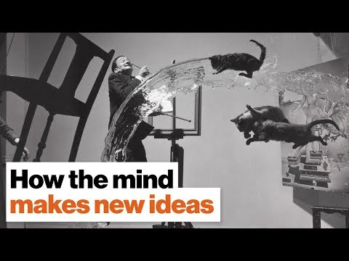
Adding to your ideas - the 3 ‘Bs’
What are the three ways in which we create new ideas?
Give an example for each one, and link it to an area of knowledge.
Notes:
The three ‘B’s link to the title of the question.
This is a video by David Eagleman, who we met in our first BQ

Slide 5
Adding to your ideas - ‘derivation’ & ‘extrapolation’
Read through the article.
What does Eagleman mean by ‘derivation and extrapolation’?
Support your interpretation of the meaning by referring to examples.

Slide 6
No such thing as plagiarism?
Watch the video.
What point is being made about films and the arts?
Notes:
Optional slide.
This is a really nice animation, so worth watching - and includes some great ideas.

Slide 7
Presenting your ideas
Create a Google Slides presentation to explain how new ideas are created.

Slide 8
Links to the TOK exhibition
Related exhibition prompt Does our knowledge depend on our interactions with other knowers? (IAP-26)
Refer to the ideas from this lesson to answer this question.
For example, think about the ways in which interactions of knowers lead to the creation of new ideas and knowledge about the world.
Which objects could help to illustrate your answer?
Notes:
Optional slide, if you want to help students to take ownership of the IA prompts (IAPs) for the TOK exhibition

Slide 9
Is true originality in the arts (or any area of knowledge) possible?
Notes:
See the BQ5 assessment tracker for suggestions on providing feedback, and recording students’ progress.

Slide 10
Linking this lesson to the course
During this lesson, we consider the highlighted aspects of the TOK course
The images used in the presentation slides can also give students ideas about selecting exhibition objects; see also our link below to specific IA prompts
CORE THEME | OPTIONAL THEMES | AREAS OF KNOWLEDGE | TOK ASSESSMENT
Knowledge & the knower | Indigenous societies | The arts | The TOK essay
 | Language | History
 | Politics | The human sciences | The TOK exhibition Could be linked to IAP-13 (improvement), IAP-26 (interactions), IAP-30 (imagination)
 | Religion | Mathematics
 | Technology | The natural sciences

Slide 11
Explore the TOK themes and areas of knowledge in more depth via a range of thinkers, media sources, and other resources, in our EXPLORATION POINTS DOCUMENTS.
Access the documents via the links below. You’ll also find the EP icons on all of the TOK course pages of the site to help you unpack the quotes, KQs, and real-life situations that you find there.
CORE THEME
Knowledge & the knower
OPTIONAL THEMES
Indigenous societies
Language
Politics
Religion
Technology
AREAS OF KNOWLEDGE
The arts
History
Human sciences
Mathematics
Natural sciences
Notes:
Use this slide to access the ‘Exploration Points’ notes for BQ5, which will help students to develop a deeper knowledge of any TOK theme or area of knowledge. This will not only help them to master the TOK course in general, but also craft a great exhibition or essay.
Be ready to provide more guidance on how to use this resource - ie, which media sources to focus on, which questions to address, which TED talks to watch, and which key terms and ideas to understand.

